Slide 1
Walmart Foundation, AIHEC, HACU, and NAFEO Student Success Collaborative Mentor Institution and Project Staff Meeting St. Mary’s University April 27-29, 2011
Rosalind V. Alderman, Ph.D.
Assistant Vice President for Retention Management
St. Mary’s University

Slide 2
About St. Mary’s University

Slide 3
Understanding Who We Are
Catholic, Hispanic Serving Institution
13:1 student to faculty ratio
Committed to hiring professors who are passionate about teaching
Notes:
Full-time faculty members are advisors

Slide 4
Fall 2010 Enrollment
4,105 total enrollment
2,437 undergraduate students
585 freshmen, 153 transfer students
70% Hispanic
50% Pell eligible

Slide 5
Fall 2010 Freshman Profile
Top majors
Biology
Psychology
Political Science
SAT/ACT
middle 50% range
950-1120 SAT (CR+M)
20-25 ACT
78% Hispanic
88% from Texas
86% live on campus
90% from public high schools

Slide 6
Parental education
Fall 2010 freshmen (95% reporting)
10%—neither parent finished high school
43%—neither parent had an associate’s or bachelor’s degree
Fall 2010 transfers
(79% reporting)
14%—neither parent finished high school
50%—neither parent had an associate’s or bachelor’s degree

Slide 7
Vision 2012 Strategic Plan
Retention and graduation goals:
Increase to 82% the retention rate from first to second year
(current average 79%)
Increase to 63% the six-year graduation rate
(current average 60%)
Notes:
Transition to retention model

Slide 8
Office of Student Retention

Slide 9
Access is not enough…..
Admission opens the door to higher education, but persistence paves the way to graduation.

Slide 10
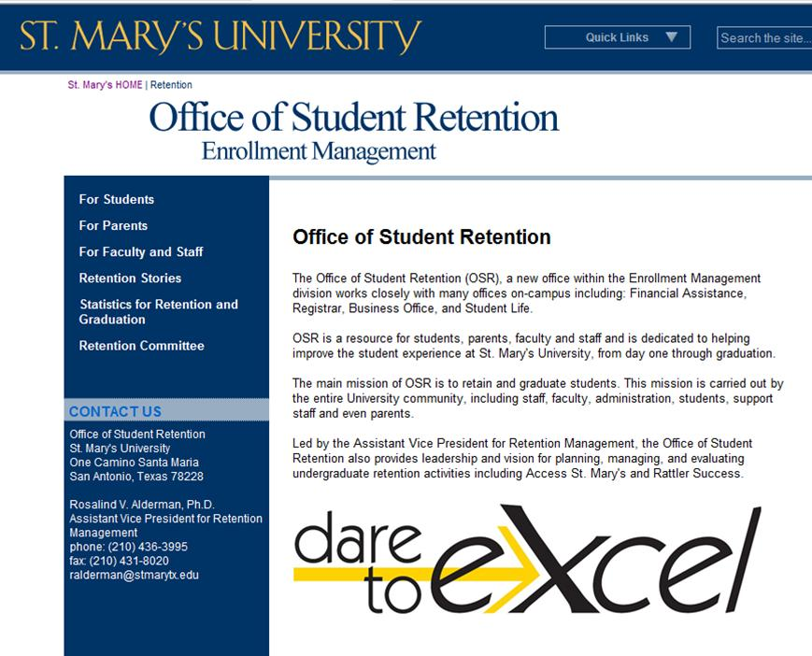
Created the Office of Student Retention
Three student interns
Modest operations budget
Focus in 3 areas:
Student outreach
Data analysis
Campus policies and procedures

Slide 11
Leadership
Retention Leadership Team:
Assistant VP
3 Vice Presidents:
Enrollment Management
Student Development
Academic Affairs
Retention Committee:
Faculty (4)
Student Government
Academic Advising
Institutional Research
Academic Assessment
Financial Assistance
Dean of Students
Marianists

Slide 12
University Reach
Residence Life
Financial Assistance
Registrar
Business Office
Academic Advising
Undergraduate Admission
Faculty
Student Life
Career Services
Academic Support Services
University Ministry
Retention Management
University Divisions
● Academic Affairs
● Administration and Finance
● Enrollment Management
● Mission & Identity
● Student Development

Slide 13
Current Programs

Slide 14
Successful high-impact initiatives:
Faculty-based advising system
DegreeWorks (new!)
ND 101- Freshman Seminar, required
McNair Scholars Program
S.U.R.F.- Summer Undergraduate Research Fellowship
Undergraduate Research Symposium
Civic engagement/career development efforts
Residence Life
Access St. Mary’s
Retention Action plan
Rattler Finish (new!)

Slide 15
Faculty Academic Mentor Program(FAM)
Faculty Academic Mentor (FAM) groups
Pilot in Fall 2009
21 faculty mentors and 74 students
Student groups of 3-4 met with faculty mentor 3-4 per semester for a meal (costs covered by OSR)

Slide 16
FAM 2010 group profile
66 student participants
First-time freshmen 74%
First time transfers 15%
Returning students 11%
Hispanic 92%
Male 36%
Female 64%
Academic school distribution:
Sciences 32%
Humanities 55%
Business 14%
Pell grant eligible—84%
41% come from families where neither parent finished HS

Slide 17
Early outcomes
Retention
First-time freshmen -3 94% retention rate (all FF at 91%)
First time transfers -0 100% retention rate (all TR at 84%)
Returning students -0 100% retention rate
Overall -3 95% retention rate
GPA
First-time freshmen:
69% GPA 3.0 or above (55% for all first-time freshmen)

Slide 18
Strengths & Challenges

Slide 19
Keys to Success
Having a point person for retention
Institutional commitment to students’ success backed by resources (time, people, money)
Campus culture
Seeking out best practices

Slide 20
Challenges
Campus culture!
“Clunky” campus policies and processes
So much data, where to begin!
Determining what makes the most impact

Slide 21
Contact:
Rosalind V. Alderman, Ph.D.
Assistant Vice President for Retention Management
210 436-3995, ralderman@stmarytx.edu
www.stmarytx.edu/retention

